Slide 1

Cleaning Reels
Poorav Sharma
30045900

Slide 2
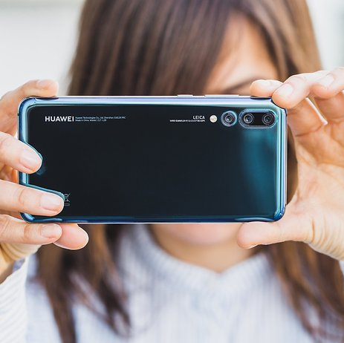
Introductions
The value of pictures taken has diminished due to:
Easy access to a camera
Larger storage space

Slide 3


Occupied space
Multiple set of pictures of the same thing make up most our photo album.
"Little drops of water,/Little grains of sand,/Make the mighty ocean/And the pleasant land./So the little minutes,/Humble though they be,/Make the mighty ages/Of eternity” – Julia Carney

Slide 4


Functionality
The app goes through the photo albums and groups similar pictures
Askes the user to review them
You choose the best ones while they deleting the rest
Frees up Storage space

Slide 5
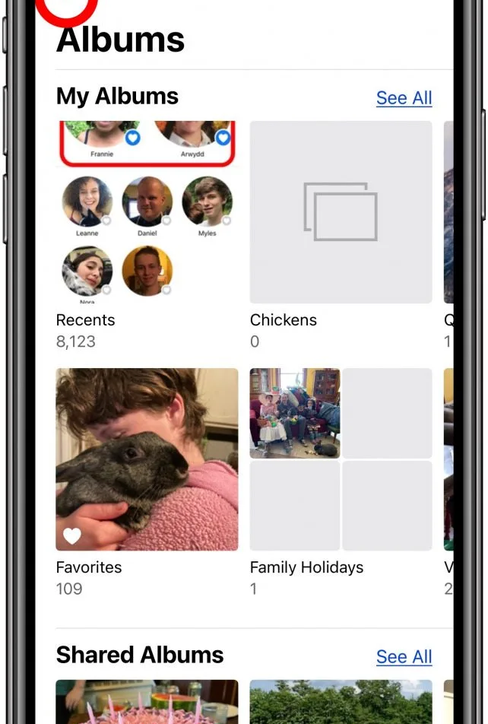
Privacy
The user can choose which album they want the app to go through.
Album not chosen are untouched.

Slide 6
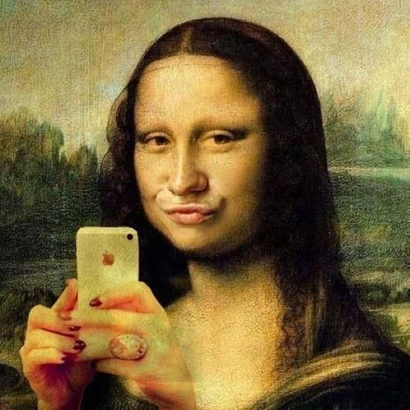
Target audience
The primary target are young audience due to their excessive photographing.

Slide 7
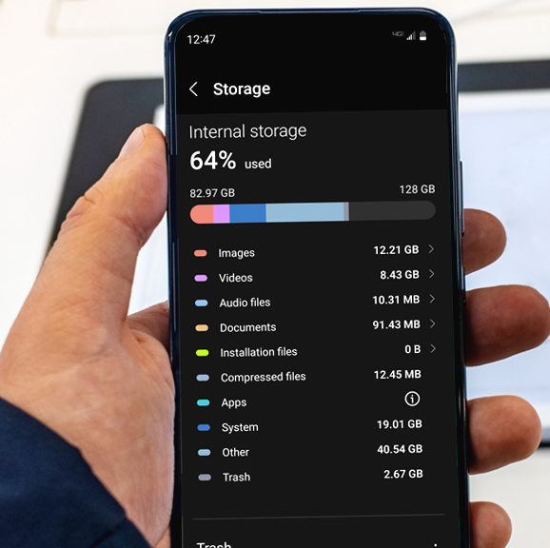
Storage required
12 MB of space required to download the app
In return helps free up a lot more space

Slide 8

Advertising
This app will be advertised in social media app such as:
Instagram
Facebook
TikTok
YouTube
Twitter etc.

Slide 9

Features
This app has a automatic feature that mergers similar pictures and keeps the one with the highest resolution.
Or you can review the batch of picture we gathered and review them before choosing the ones you want to keep

Slide 10

Competition
This app is not just about freeing up storage. It is about giving the users the chance to relive past events through the pictures we present to them.

Slide 11

Questions

